Slide 1

Simplifying Data Ops with LakeFS
Ryan Skinner – Sales Engineer

Slide 2


Agenda
Introduction
LakeFS Use-Cases
Key Considerations
LakeFS Architecture

Slide 3


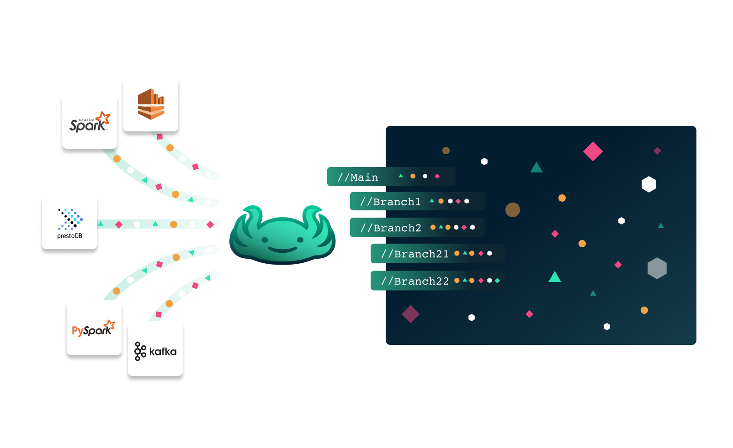
Introduction
LakeFS is a powerful open-source project that provides a git-like version control interface for data lakes, with seamless integration to most data tools and frameworks.

Slide 4
LakeFS Use-Cases:
Development
Deployment
Production
Experiment – Create isolated data snapshots to run experiments other without risking production data
Debug – Checkout specific commits to see the exact state of your data at time of error
Collaborate – Leverage isolated branches managed by metadata to work in parallel
Version Control – Retain commits so readers can “time-travel” within the data lake
Test – Define pre-merge and pre-commit hooks to test data before they reach production.
Roll Back – Recover from errors instantly by reverting data to a former, consistent snapshot of the data lake
Troubleshoot – spend less time re-creating the state of datasets at the time of failure, and more time finding the solution
Cross-collection Consistency – Update data lake in one atomic action, merging to the production branch only after all datasets have been created or updated successfully

Slide 5
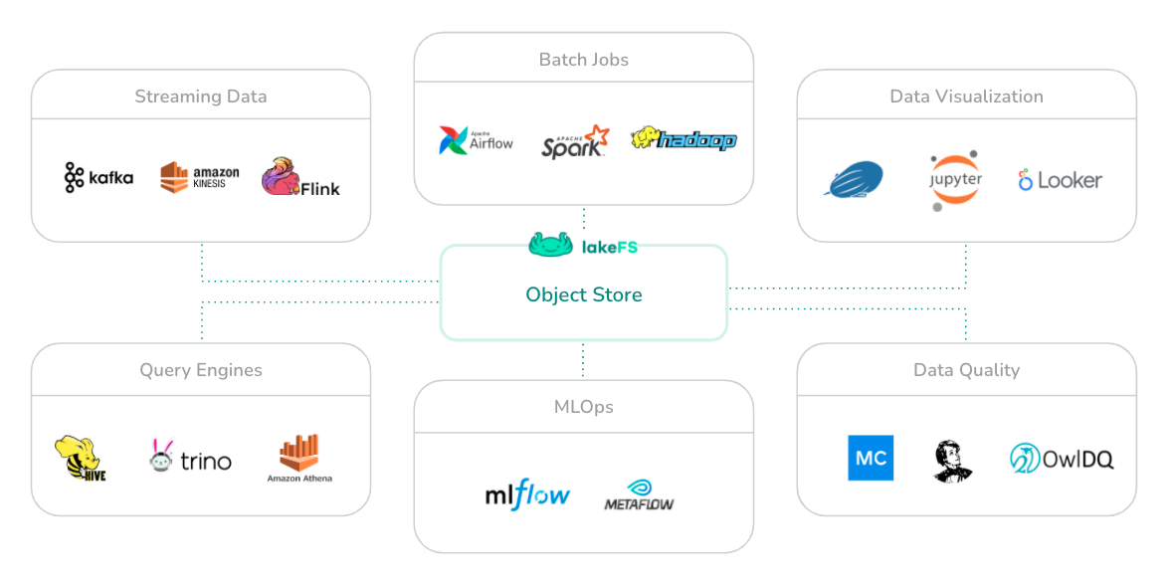
Other Considerations
Format Agnostic – Open to any format supported by underlying data lake
Built for Big Data – Highly performant for huge data lakes
Data Stays In Place – No migration to external servers
Copy on Write – Helps prevent unnecessary data duplication
S3 API – Consistent S3 API0 streamlines integration with other services using the S3 API

Slide 6
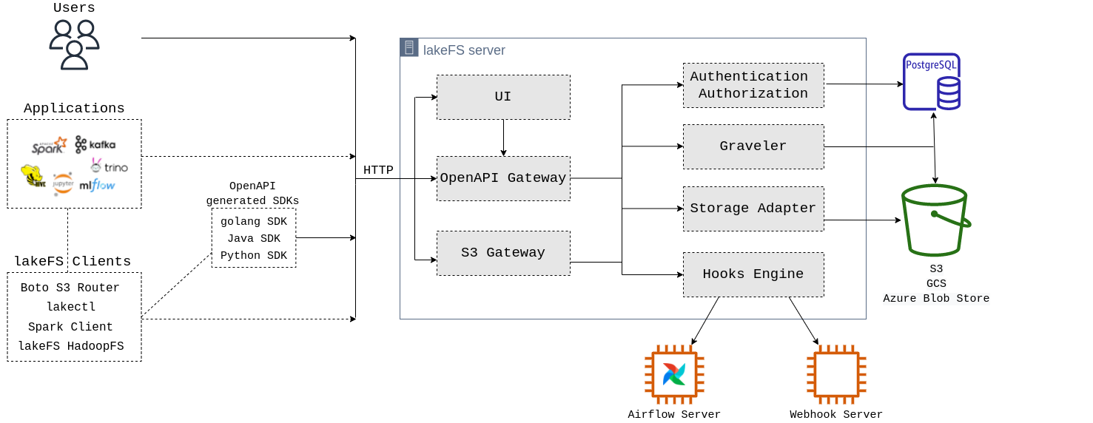
LakeFS Architecture
LakeFS Architecture allows seamless integration with other applications using the S3 API and convenient SDKs to integrated with modern Data Engineering stacks

Slide 7

LakeFS allows businesses to successfully utilize data lakes by streamlining the Data Ops processes, eliminating the risk of polluting production data, and enabling isolated experimentation for development teams and end-users.

Slide 8
Thank You
Ryan Skinner
https://lakefs.io

Slide 9
Appendix

Slide 10
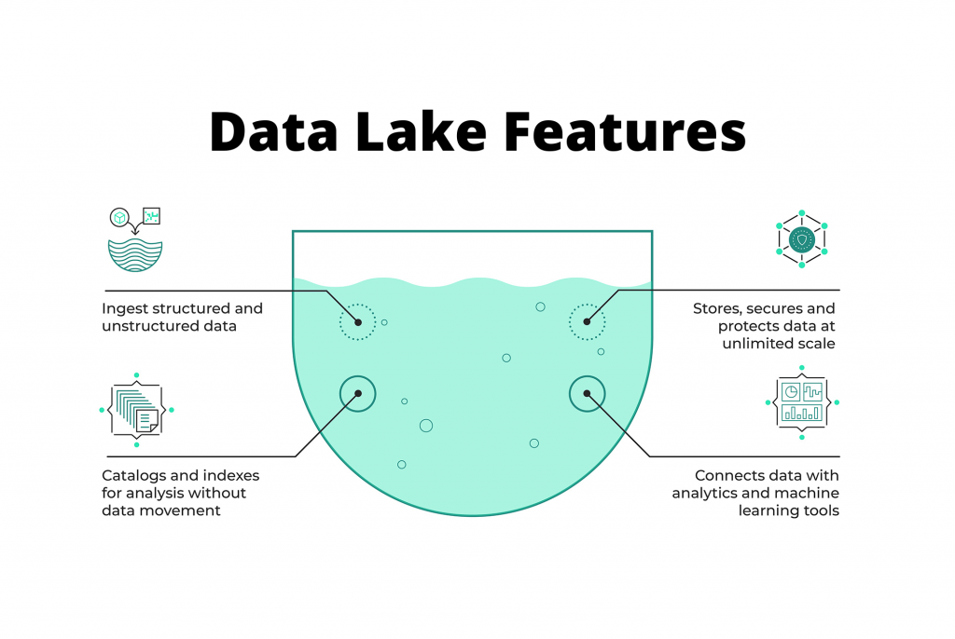
What is a Data Lake?
A data lake allows for the querying of data in file or blob objects
Data lake architectures encourage consolidation of data assets into a centralized repository, enabling cross-functional analysis of previously siloed data

Slide 11
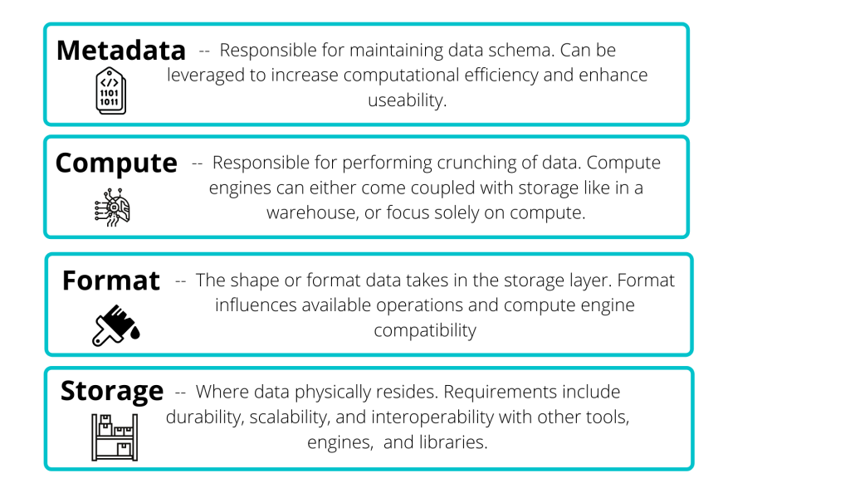
Data Lake Primary Components

Slide 12
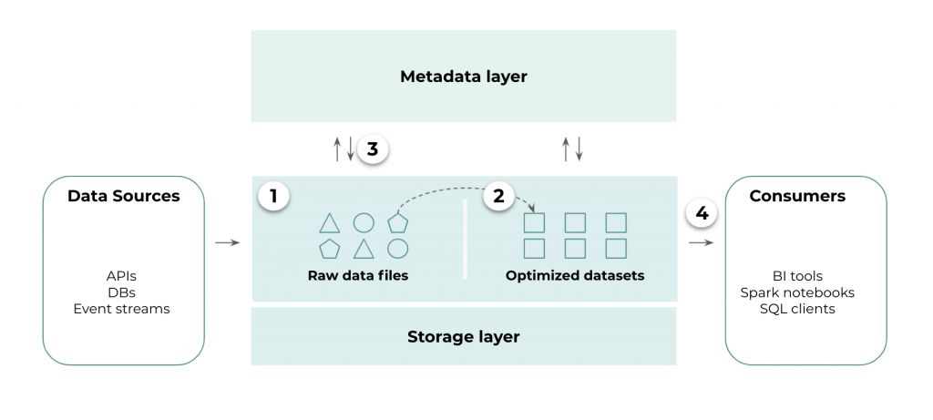
Data Lake Architecture
Good-Practice Data Lake Components
Raw data in the object storage (e.g., S3)
Optimize raw data files for analysis
Metadata tooling to define schema and enable versioning
Integrate downstream consumers to optimized assets

Slide 13
Data Lake Challenges

